Slide 1

Moths!
Samuel Mashil

Slide 2
Background
Helicoverpa armigera is one of the world’s worst crop pests, and recently invaded South America.
Hybridised with Helicoverpa zea, spreading resistance genes
Difficult to distinguish – already a long genotyping process
Idea – create a machine learning model to distinguish species in the field using nothing but images of the moths’ wings

Slide 3
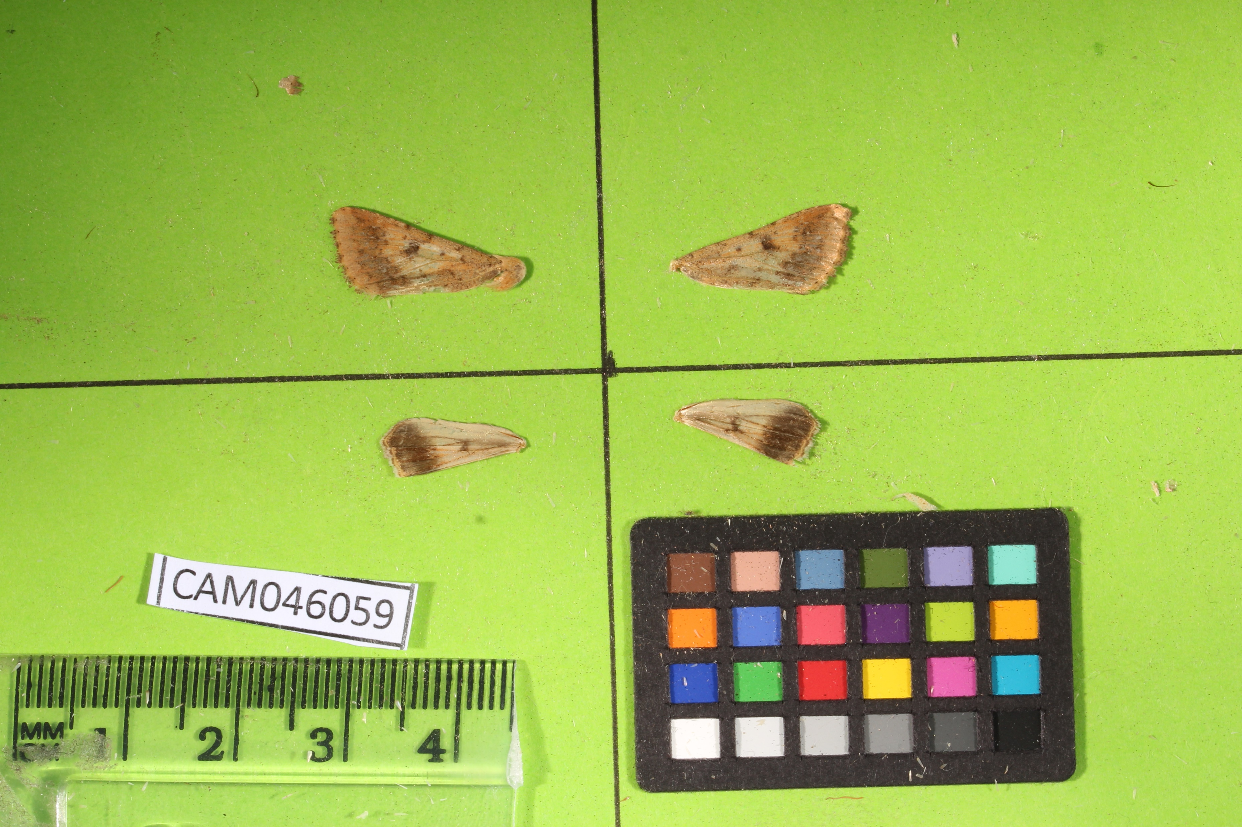

Slide 4

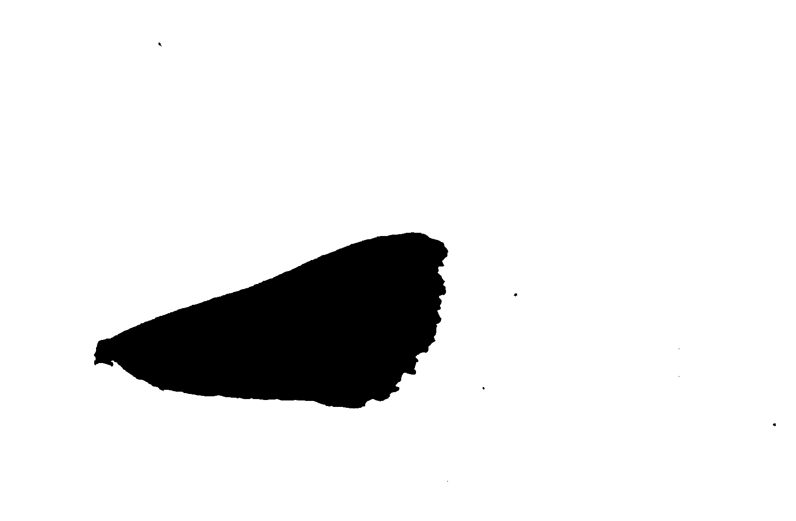

Slide 5
Extracted Features
Area
Major/minor axes lengths
Circularity
Feret and minimum feret
Aspect Ratio
Shape
Colours

Slide 6

Simple Algorithms
Logistic Regression
Linear Discriminant Analysis (LDA)

Slide 7

Simple Algorithms
Logistic Regression
$$p=\frac{1}{1+e^{−\left(a_{0}+a_{1}X_{1}+a_{2}X_{2}+…\right)}}$$
Linear Discriminant Analysis (LDA)

Slide 8
Findings
LDA works best
Logistic Regression: 76.94% ± 2.92
LDA: 77.82% ± 1.37

Slide 9
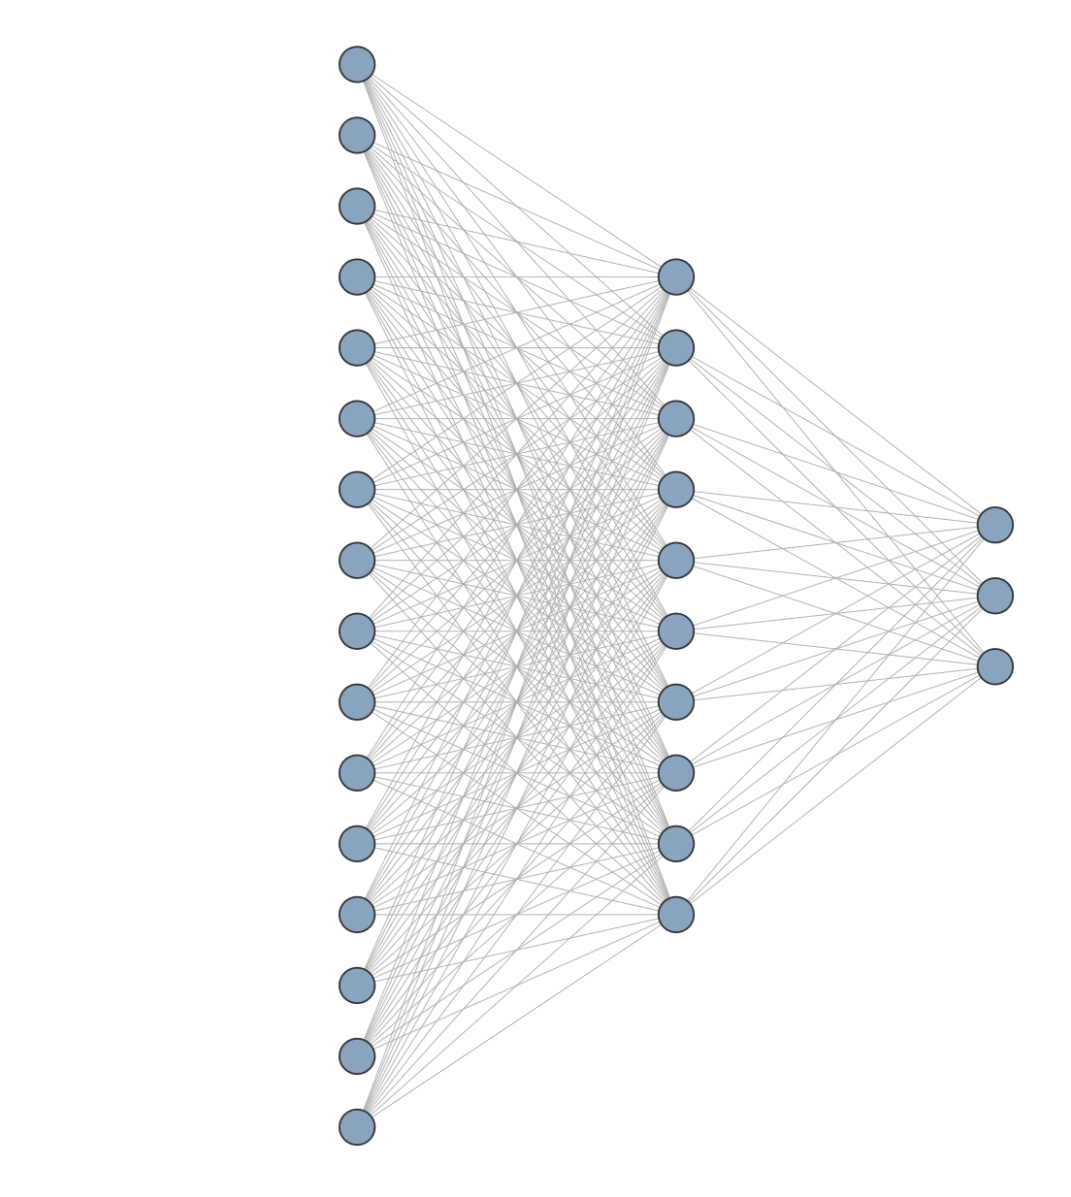
Moving onto neural networks
Initially using the same previously-determined extracted features
Best architecture seemed to be a single hidden layer with 10 nodes
Accuracy: 76.43% ± 2.31

Slide 10
Image-based neural network
Not so good
Average Accuracy: 71.898% ± 2.146
Pretrained model (VGG16)
Accuracy: 72.606%
Clearly less accurate than using the extracted features

Slide 11

Refining the network
Learning rate scheduler
Early stopping
Batch normalisation
Different architectures
Learning rate scheduler
Early stopping
Dropout
Regularization
Batch normalisation
Different architectures
Gradient clipping
Early stopping
Batch normalisation
Dropout
Regularization
Different architectures
Gradient clipping

Slide 12
Refining the network
Learning rate scheduler
Early stopping
Batch normalisation
Different architectures
Accuracy: 80.502% ± 2.051
Learning rate scheduler
Early stopping
Dropout
Regularization
Batch normalisation
Different architectures
Gradient clipping
Early stopping
Batch normalisation
Dropout
Regularization
Different architectures
Gradient clipping

Slide 14
Most relevant features
Colour – specifically ventral (front side) colour
More green and blue suggests zea
More red suggests armigera
Feret and minimum feret diameters
Higher feret diameter suggests zea
Higher minimum feret diameter suggests armigera
Area
Larger area suggests zea

Slide 15
Class Imbalance Over 72% armigera!

Slide 16

Baselines
Zero Weight Baseline – always predicting the majority class
$72.6\%$ accuracy
Random Rate Baseline – guessing randomly, but weighted according to class balance
${0.7256}^{2}+{0.1403}^{2}+{0.1340}^{2} = 0.56421897822≈56.4\%$

Slide 17
Balancing the Classes
Over-sampling or under-sampling: both give similar results
Accuracy: 65.31% ± 6.91
Baseline in this case would be around 33%, so performance is much better.

Slide 18
Conclusions
Machine learning works!
Whilst not perfect, the final model still performs its role as an aid to farmers in the field
Could be improved with more data or further refinement
Future ideas:
Explore models deeper – how each feature individually affects each models
How these effects differ across wings/samples
Finetuning models accordingly to better fit each wing specifically

